Slide 1
Spam/Ham Machine Learning Classifier
Jason Contreras, Mohammad Arain, Robert Meis
CST 383 Spring 2021 Data Science Project
Professor Mehmet Ergezer

Slide 2
Table of Contents
Introduction
Selection of Data
Methods
Results
Summary
Discussion
Data Visualization
Models
References/Bibliography

Slide 3
Introduction
Kaggle Dataset
Spam/Ham Classifier
Widely used technique for e-mail filtering
Goal: Build a Spam/Ham Classifier with high accuracy
If email messages are well classified
More efficient resource and time allocation
Reduced overhead costs
Better workflow
Better security
Notes:
The purpose of this project is to create a Spam/Ham Classifier with high accuracy. Spam/Ham classifiers are a widely used technique for e-mail filtering. This project was undertaken because it piqued our interest, is popular in our field of computer science and is applicable towards our class curriculum.
reduce potential phishing emails

Slide 4
Selection of Data
Categorical
text
label
Numerical
number (nnamed)
label_num
Drop
number
Label
“Email Subjects” in text
spam_ham_dataset.csv
-5,170 Enron Emails
- 4 Columns of Data
Notes:
Data consists of a publicly available dataset containing a total of 5171(~5000) Enron emails. Before data munging, original data consists of four columns: number, label, text, label_num
Data Fields
Unamed:0 (Number) - Unique id of Message
Label - Type of message (Spam or Ham)
Text - Actual Message
label_num - Type of message (0 = ham, 1 = Spam)
Data Munging:
-Email number (0-5000) was dropped from the data set to avoid biasing. -Label was also dropped as it was irrelevant to the ML algorithm which will use numeric values. -Each email subject began with "Subject: ". This was stripped from each email subject using Python string processing as it was both irrelevant and potentially biasing.

Slide 5
Selection of Data
Categorical
text
label
Numerical
number (nnamed)
label_num
Drop
number
Label
“Email Subjects” in text
spam_ham_dataset.csv
-5,170 Enron Emails
- 4 Columns of Data
Notes:
Data consists of a publicly available dataset containing a total of 5171(~5000) Enron emails. Before data munging, original data consists of four columns: number, label, text, label_num
Data Fields
Unamed:0 (Number) - Unique id of Message
Label - Type of message (Spam or Ham)
Text - Actual Message
label_num - Type of message (0 = ham, 1 = Spam)
Data Munging:
-Email number (0-5000) was dropped from the data set to avoid biasing. -Label was also dropped as it was irrelevant to the ML algorithm which will use numeric values. -Each email subject began with "Subject: ". This was stripped from each email subject using Python string processing as it was both irrelevant and potentially biasing.

Slide 6
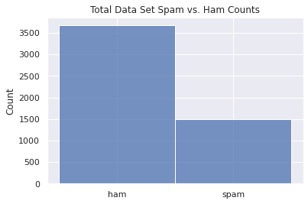
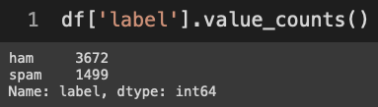
Data Visualization
spam_ham_dataset.csv
-5,170 Enron Emails

Slide 7
Methods
Tools:
Numpy, Pandas, Matplotlib, Scikit-Learn, and Seaborn for data analysis and visualization
Scikit-learn for inference
Github for and version control
Spyder as IDE
Google Collaboratory for Python Notebook
Inference methods used with Scikit:
Models:
DecisionTreeClassifier
Naïve-Bayes
RandomForestClassifier
KNeighborsClassifier
Features:
TfidfVectorizer for weighing words values
Split Data using a 70/30 Split
Notes:
TFIDF Vectorizer was used to transform each word or "term" in the email subject into a weighted value reflecting its frequency within a document type (spam or ham). TFIDF Vectorizer assigns an inverse weighting to terms occurring frequently across documents, such as "the" and "and," so words weighted highly are more meaningful.

Slide 8
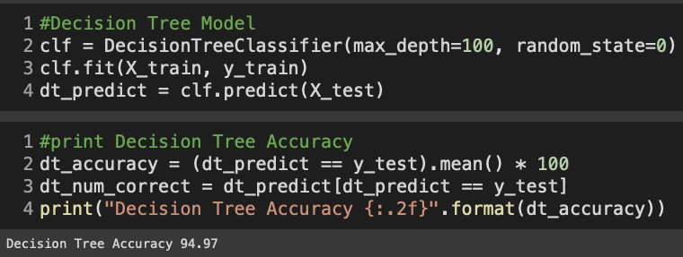
Model 1 - Decision Tree
Notes:
Decision Trees are supervised non-parametric technique that is capable of classification and regression related work. The data is split continuusly depending on a specific parameter. The parameter max_depth represents the maximum depth of the tree.
Tuning DT to have a max leaf depth of >= 15 led to higher accuracy on untrained test data, with an optimal accuracy of 0.94 at a max_depth = 15, where higher max_depth values provided minimal or no additional improvement.

Slide 9
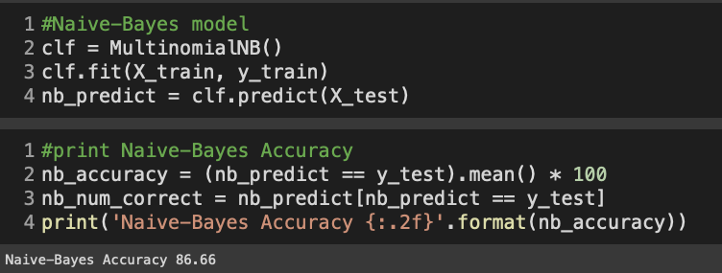
Model 2 - Naive-Bayes
Notes:
Naive-Baiyes is a context classifier that applies Bayes' theorem on the context of each email. It assumes the words in each e-mail are independent from each other.
With default values for each model Naive-Bayes showed the highest accuracy at 87%

Slide 10
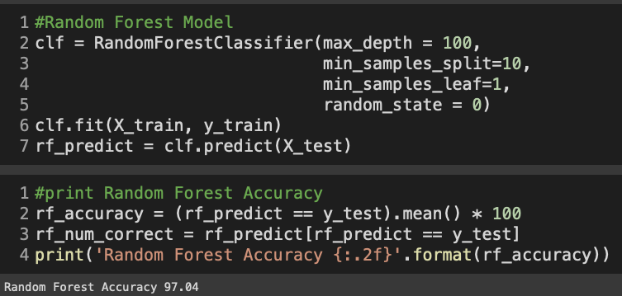
Model 3 – Random forest
Notes:
Random Forests is an ensemble algorithm that uses bagging (or bootstrap aggregation). A certain number of decision trees are created for a specific problem and merged together for a more accurate prediction.
Random Forest was then tested to determine whether it would provide a higher accuracy level vs. Decision Trees. Using default params, Random Forest had lower accuracy than DT (around 70%). Experimental tuning of params increased accuracy slightly, such as setting a min_samples_split to 10. However, expanding the max_depth param of Random Forest to 100 increased its accuracy to 97%, the highest of any of the three models. Matching that max_depth of 100 with Decision Trees did not increase the accuracy of DT.

Slide 11
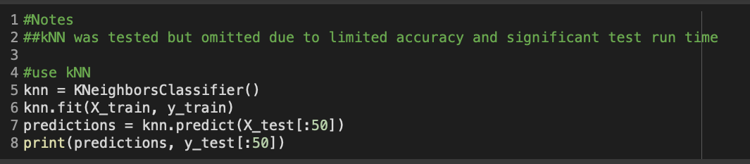
Model – KNN (Abandoned)
Notes:
kNN Neighborsclassifier proved to be inefficient for our large dataset as the TFDIF Vectorizer produced too many columns for kNN to handle.

Slide 12
Discussion
Model
Default Parameters
Decision Trees
80% Accuracy
Fine Tuned Parameters
95% Accuracy
Naïve-Bayes
87% Accuracy
87% Accuracy
Random Forest
70% Accuracy
97% Accuracy
Notes:
Our observed accuracies through out the process of model testing and hyperparameter fine tuning.
Tuning Decision Trees to have a max leaf depth of greater than or equal to 15 led to a higher accuracy on untrained test data, with an optimal accuracy of 0.94 at a max_depth = 15. Furthermore, higher max_depth values provided minimal or no additional improvement. Random Forest was then tested to determine whether it would provide a higher accuracy level vs. Decision Trees. Using default params, Random Forest had lower accuracy than Decision Trees (around 70%). Experimental tuning of parameters increased accuracy slightly, such as setting a min_samples_split to 10. However, expanding the max_depth parameter of Random Forest to 100 increased its accuracy to 97%, the highest of any of the three models.

Slide 13
Results
Decision Trees
95% Accuracy
Naïve-Bayes
87% Accuracy
Random Forest
97% Accuracy
Notes:
Final results Overview

Slide 14
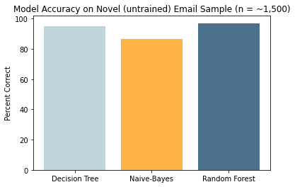
Results
Notes:
Model Accuracies Graphed
The results do imply that the three linear ML classifiers tested (Decision Tree, Naive-Bayes and Random Forest) are all viable approaches for a spam/ham classifier; which aligns with what researchers say according to ScienceDirect. The 97% accuracy on Random Forest also does reinforce the fact that Random Forest is capable of high classification accuaracies and worked best for our goal of a high accuaracy.

Slide 15
Summary
Most Capable: Random Forest Model even with minimal tuning.
Future Expansions:
GridSearch for decision trees
Boosting
Support Vector Machining(SVS)
Artificial Neural Networks (ANN)
Notes:
Therefore, it was determined that Random Forest was the optimal model of the three
Based on the simulation results Decision Tree, Naive-Bayes and Random Forest have all proven to be capable machine learning algorithmns to base a spam/ham classifier
Other potential factors to extend this project in the future could include grid search for decision trees, boosting, support vector machines(SVS) and Artificial Nueral networks (ANN).

Slide 16
References/Bibliography
https://jakevdp.github.io/PythonDataScienceHandbook/05.04-feature-engineering.html
https://jakevdp.github.io/PythonDataScienceHandbook/05.05-naive-bayes.html
https://pandas.pydata.org/ (multiple pages)
https://scikit-learn.org/ (multiple pages)
https://seaborn.pydata.org/ (multiple pages)
https://matplotlib.org/ (multiple pages)
https://www.kite.com/python/answers/how-to-plot-a-bar-chart-using-a-dictionary-in-matplotlib-in-python
https://python-graph-gallery.com/3-control-color-of-barplots/
https://www.sciencedirect.com/science/article/pii/S2405844018353404
Spam/Ham Dataset is obtained here: https://www.kaggle.com/venky73/spam-mails-dataset
Data was downloaded on Feb 7 2021

